Slide 1
04-Graph algorithms –Minimum Spanning Tree, Shortest Path algorithms
Mr. Ullas S.
Assistant Professor (Sr. Gr.)
CSE, ASC, Amrita Vishwa Vidyapeetham,
Bengaluru

Slide 2
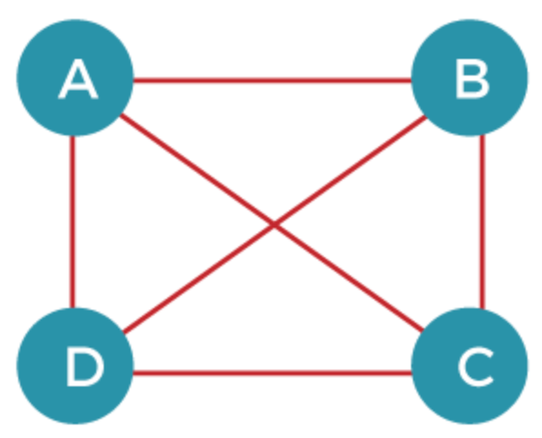
Spanning Tree
Graph can be represented as G(V, E), where 'V' is the number of vertices, and 'E' is the number of edges.
The spanning tree of the above graph would be represented as G`(V`, E`).
In this case, V` = V means that the number of vertices in the spanning tree would be the same as the number of vertices in the graph.
The number of edges in the spanning tree is the subset of the number of edges in the original graph.

Slide 3
Spanning Tree – Contd.
The number of vertices in the spanning tree would be the same as the number of vertices in the original graph. V` = V
The number of edges in the spanning tree would be equal to the number of vertices minus 1. E` = |V| - 1
The spanning tree should not contain any cycle.
The spanning tree should not be disconnected.

Slide 4
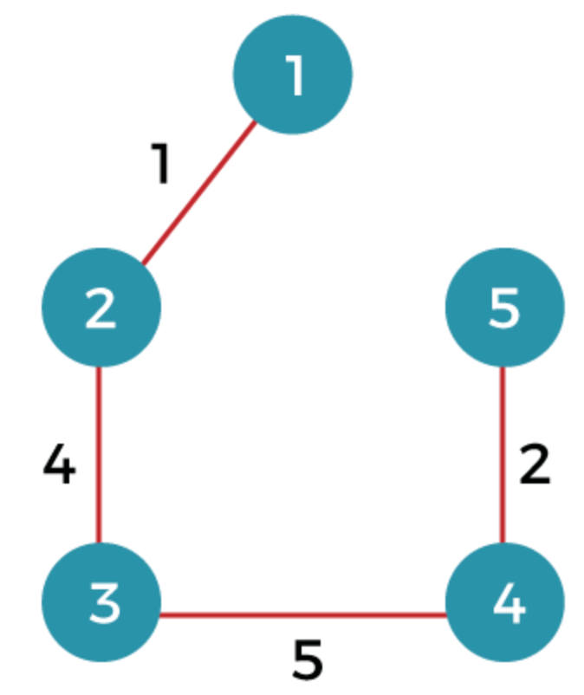
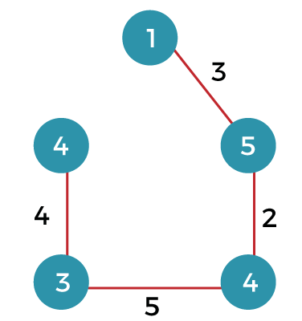
Spanning Tree- Contd.

Slide 5
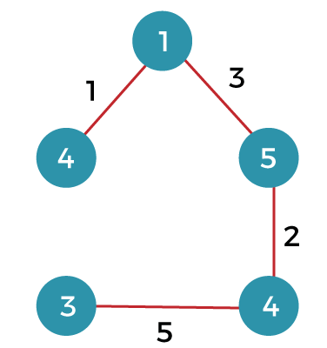
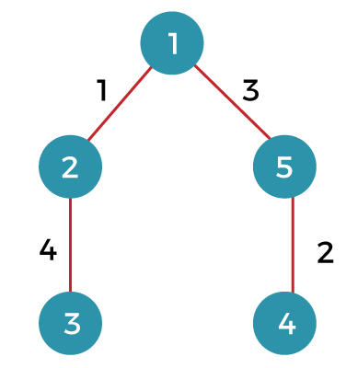
Spanning Tree- Contd.

Slide 6
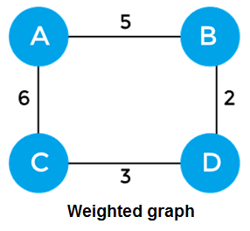
Minimum Spanning Tree
The minimum spanning tree is a spanning tree whose sum of the edges is minimum. Consider the below graph that contains the edge weight:
Notes:
The first spanning tree is a tree in which we have removed the edge between the vertices 1 and 5 shown as below: The sum of the edges of the above tree is (1 + 4 + 5 + 2): 12
The second spanning tree is a tree in which we have removed the edge between the vertices 1 and 2 shown as below: The sum of the edges of the above tree is (3 + 2 + 5 + 4) : 14
The third spanning tree is a tree in which we have removed the edge between the vertices 2 and 3 shown as below: The sum of the edges of the above tree is (1 + 3 + 2 + 5) : 11
The fourth spanning tree is a tree in which we have removed the edge between the vertices 3 and 4 shown as below: The sum of the edges of the above tree is (1 + 3 + 2 + 4) : 10. The edge cost 10 is minimum so it is a minimum spanning tree.

Slide 7
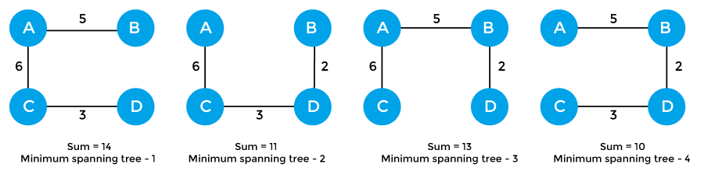
Minimum Spanning Tree

Slide 8
General properties of minimum spanning tree
If we remove any edge from the spanning tree, then it becomes disconnected.
If we add an edge to the spanning tree then it creates a loop.
There can be a maximum n^{n-2} number of spanning trees that can be created from a complete graph
A spanning tree has n-1 edges, where 'n' is the number of nodes.
If the graph is a complete graph, then the spanning tree can be constructed by removing maximum (e-n+1) edges, where 'e' is the number of edges and 'n' is the number of vertices.

Slide 9
Applications of minimum spanning tree
Algorithms for Minimum spanning tree
Minimum spanning tree can be used to design water-supply networks, telecommunication networks, and electrical grids.
It can be used to find paths in the map.
Prim's Algorithm
Kruskal's Algorithm

Slide 10
Prim's algorithm
It is a greedy algorithm that starts with an empty spanning tree. It is used to find the minimum spanning tree from the graph.
This algorithm finds the subset of edges that includes every vertex of the graph such that the sum of the weights of the edges can be minimized.
Notes:
To learn more about the prim's algorithm, you can click the below link - https://www.javatpoint.com/prim-algorithm

Slide 11
Prim's algorithm Steps
Step 1: Select a starting vertex
Step 2: Repeat Steps 3 and 4 until there are fringe vertices
Step 3: Select an edge 'e' connecting the tree vertex and fringe vertex that has minimum weight
Step 4: Add the selected edge and the vertex to the minimum spanning tree T
[END OF LOOP]
Step 5: EXIT
Notes:
Prim's algorithm can be simply implemented by using the adjacency matrix or adjacency list graph representation, and to add the edge with the minimum weight requires the linearly searching of an array of weights. It requires O(|V|²) running time. It can be improved further by using the implementation of heap to find the minimum weight edges in the inner loop of the algorithm.

Slide 12
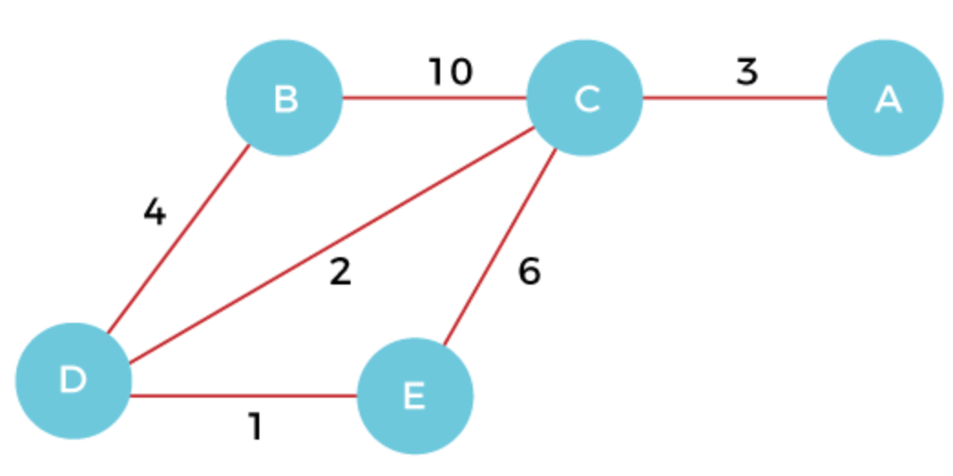
Prim's algorithm – Eg.

Slide 13
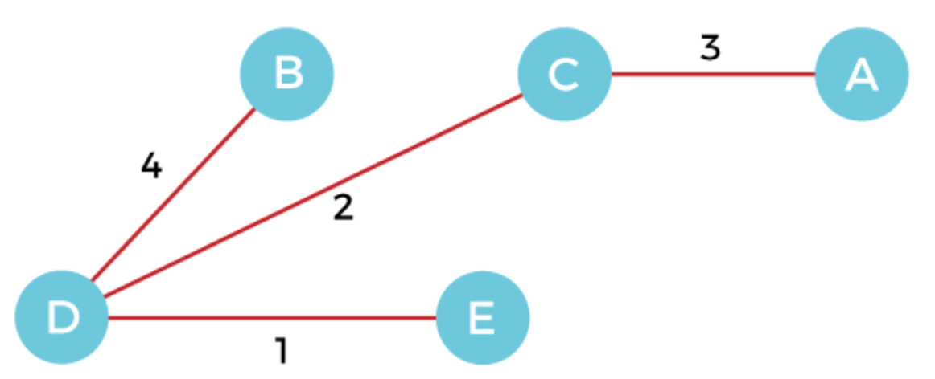
Prim's algorithm – Eg.
Cost of MST = 4 + 2 + 1 + 3 = 10 units.

Slide 14
Kruskal's algorithm
This algorithm is also used to find the minimum spanning tree for a connected weighted graph.
Kruskal's algorithm also follows greedy approach, which finds an optimum solution at every stage instead of focusing on a global optimum.

Slide 15
Kruskal's algorithm - steps
Step 1: Create a forest F in such a way that every vertex of the graph is a separate tree.
Step 2: Create a set E that contains all the edges of the graph.
Step 3: Repeat Steps 4 and 5 while E is NOT EMPTY and F is not spanning
Step 4: Remove an edge from E with minimum weight
Step 5: IF the edge obtained in Step 4 connects two different trees, then add it to the forest F
(for combining two trees into one tree).
ELSE
Discard the edge
Step 6: END

Slide 16
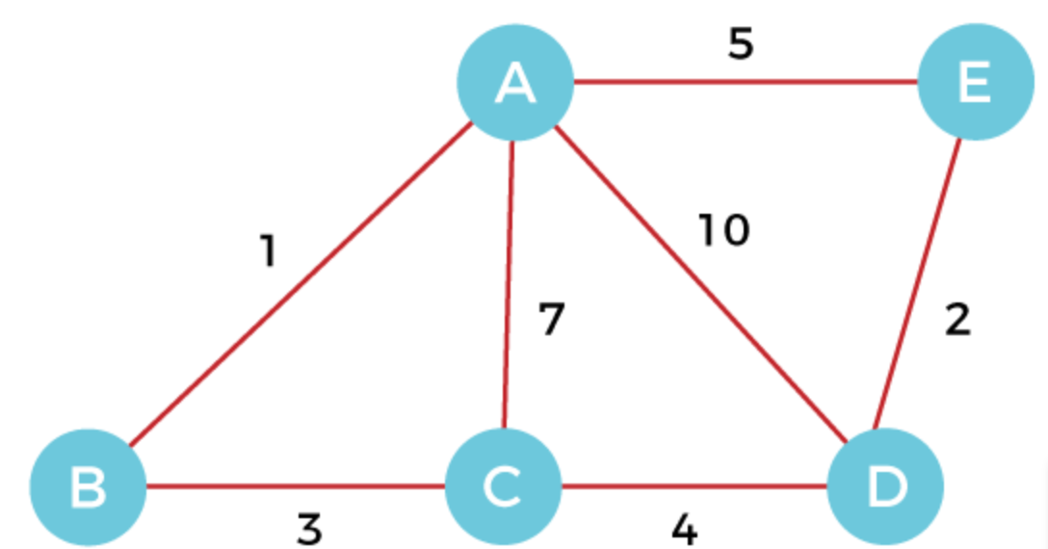
Kruskal's algorithm - Eg

Slide 17
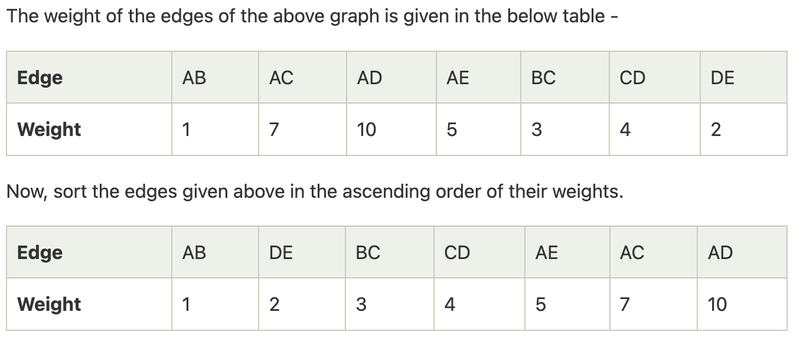
Kruskal's algorithm - Eg

Slide 18
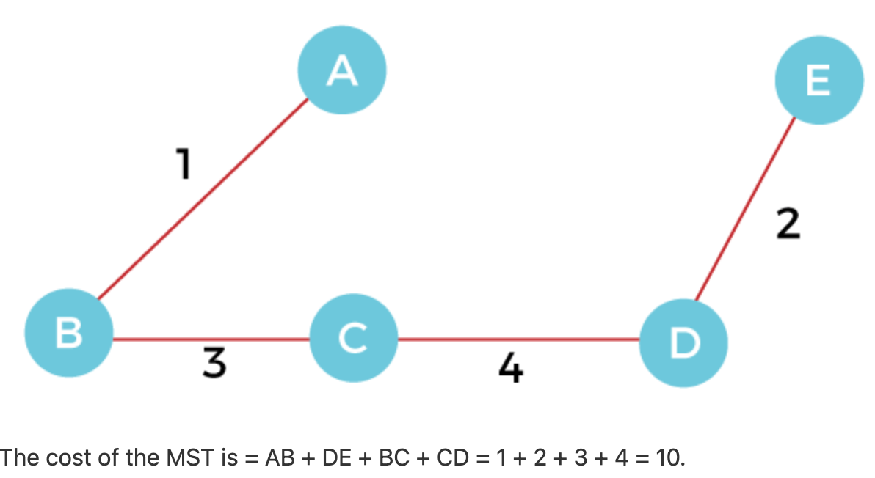
Kruskal's algorithm - Eg

